Slide 1
SCQR framework
Situation
Complication
Question
Resolution
Notes:
Logical progression of ideas.

Slide 2
SCQR framework
Situation
Complication
Question
Resolution

Slide 3
SCQR framework
Situation
Complication
Question
Resolution

Slide 4
SCQR framework
Situation
Complication
Question
Resolution

Slide 5
SCQR framework
Situation
Complication
Question
Resolution

Slide 6
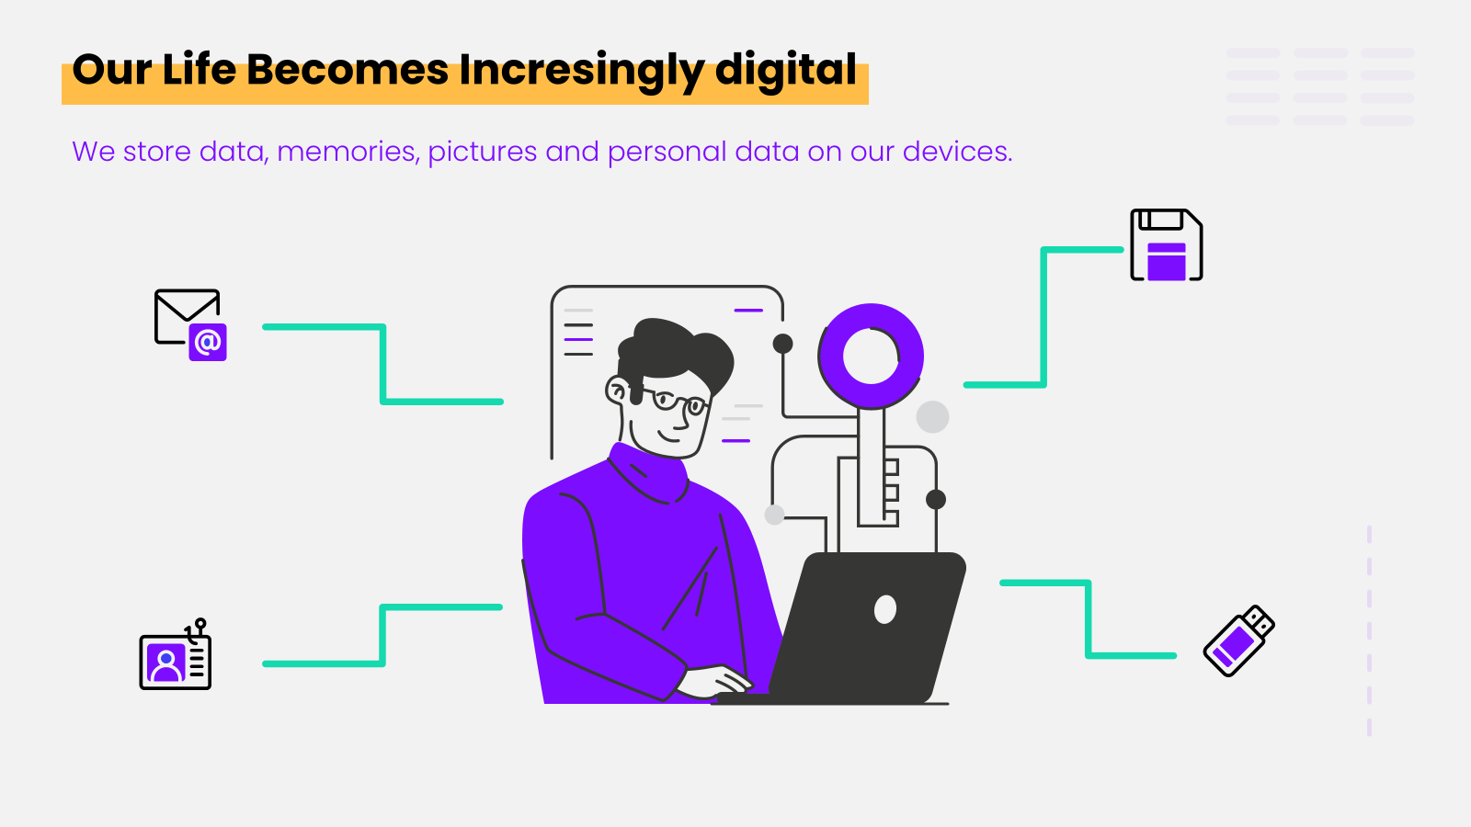
SCQR framework
Situation
Set the context
Provide background
Establish the starting point
Complication
Question
Resolution

Slide 7
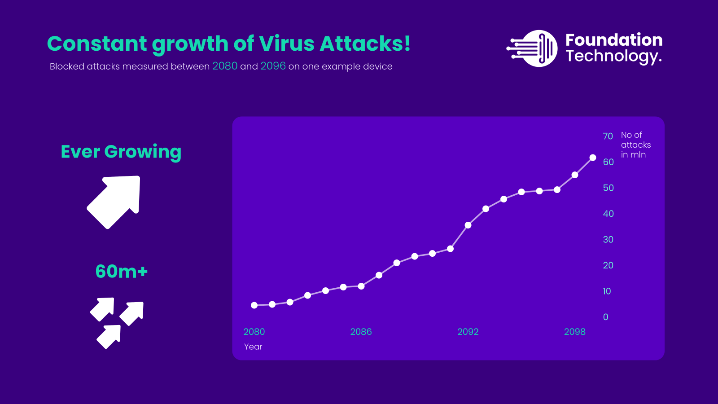
SCQR framework
Situation
Complication
Set the context
Provide background
Establish the starting point
Introduce the problem
Highlight the challenge
Create tension
Question
Resolution

Slide 8
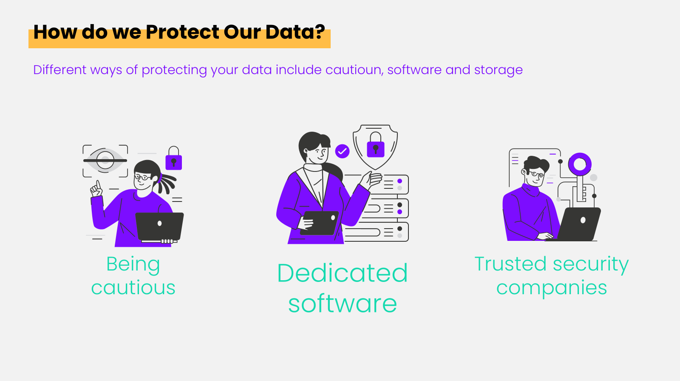
SCQR framework
Question
Situation
Complication
Set the context
Provide background
Establish the starting point
Introduce the problem
Highlight the challenge
Create tension
Focus on the key issue
Guide the audience's curiosity
Drive the need for a solution
Resolution

Slide 9
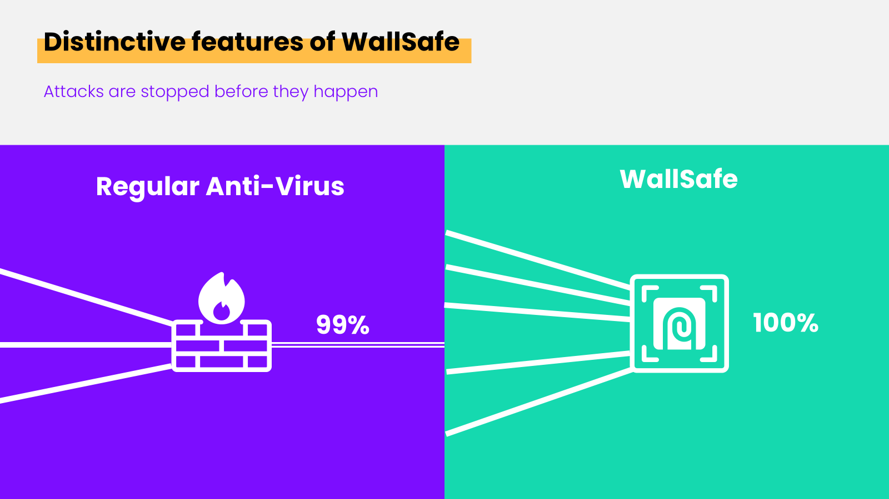
SCQR framework
Resolution
Question
Situation
Complication
Offer a solution
Address the complication
Conclude the narrative
Set the context
Provide background
Establish the starting point
Focus on the key issue
Guide the audience's curiosity
Drive the need for a solution
Introduce the problem
Highlight the challenge
Create tension

Slide 10
Typical presentation
Boring introduction
Long and tedious slides
Finally a conclusion

Slide 11
Pyramid Principle
Main idea / the answer
Supporting arguments
Supporting facts / data

Slide 12
Pyramid Principle
WallSafe
Main idea / the answer
100% instead of 99%
Supporting arguments
Show the dashboard
Supporting facts / data

Slide 13

Constant growth of Virus Attacks!
Blocked attacks measured between 2080 and 2096 on one example device
No of attacks in mln
Ever Growing
60m+
Year
Notes:
Slide 2: Complication
Title: Growing Cyber Threats Content: Cyber threats like malware, ransomware, and viruses are more prevalent and sophisticated. Number of attacks growing

Slide 14
Main idea
Constant growth of Virus Attacks!
Blocked attacks measured between 2080 and 2096 on one example device
No of attacks in mln
Ever Growing
Supporting arguments
60m+
Year
Supporting facts / data
Notes:
Slide 2: Complication
Title: Growing Cyber Threats Content: Cyber threats like malware, ransomware, and viruses are more prevalent and sophisticated. Number of attacks growing

Slide 15
Visual Storytelling in Presentaitons blueprint
1. Establish branding
Font, Colors, Icons, Logo – a brand book to work off. Add it to your PPT template
2. Draft content
Decide upon a framework, sketch out presentation slides, flow
3. Design presentation
Make it visually appealing, use little text
4. Animate and polish
Practice talking, presenting, animations

